Slide 2
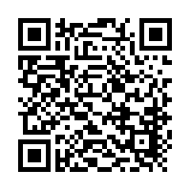
Station #1
1. What day is Shakespeare’s birthday?
2. Who was Shakespeare’s wife?
3. Where was Shakespeare born?

Slide 3
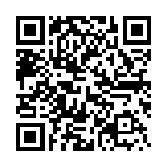
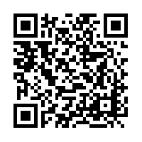
Station #2
1. How many sonnets did Shakespeare write?
2. What are two kinds of play Shakespeare wrote?
3. Name a king or queen for Shakespeare worked.

Slide 4
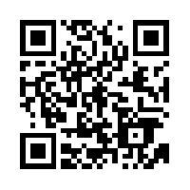
Station #3
1. What was Shakespeare’s main job title?
2. Name the theater where Shakespeare worked.
3. How many plays did Shakespeare write?

Slide 5
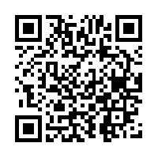
Station #4
1. Who was Shakespeare’s patron?
2. To whom did Shakespeare leave his effects after his death?
3. Was Shakespeare a real person?

Slide 6
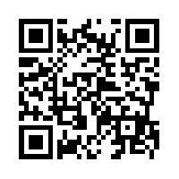
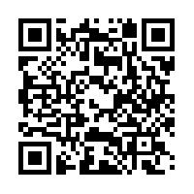
Station #5
1. What is a division within a play much like chapters of a novel?
2. What are lines that are spoken by a character directly to the audience?
3. What is a list of characters presented before the action begins?

Slide 7
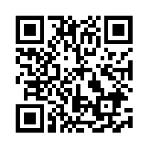
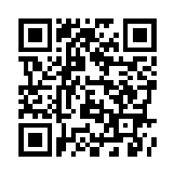
Station #6
1. What is a person or group of people who act as a narrator, commentator, or general audience to the action of the play?
2. What is a humorous work of drama?
3. What is conversation between two or more characters?

Slide 8
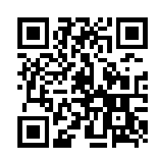
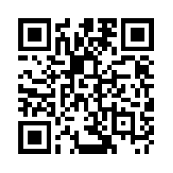
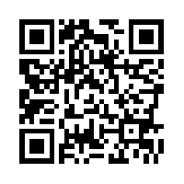
Station #7
1. What is a work of literature designed to be performed in front of an audience?
2. What is a character who is nearly opposite of another character?
3. What is a long speech spoken by a character to himself, another character, or to the audience?
4. What is a division of an act into smaller parts?

Slide 9
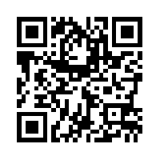
Station #8
1. What are thoughts spoken aloud by a character when he/she is alone, or thinks he/she is alone?
2. What are italicized comments that identify parts of the setting or the use of props or costumes, give further information about a character, or provide background information; in Shakespeare‘s plays, stage directions can also appear in brackets, parenthesis, and/or half-brackets?
3. What is a serious work of drama in which the hero suffers catastrophe or serious misfortune, usually because of his own actions?

Slide 10
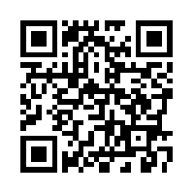
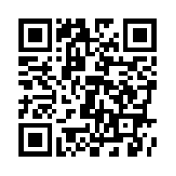
Station #9
1. What is a repetition of consonant sounds at the beginning of words or stressed syllables (i.e. ―Peter Piper picked a peck of pickled peppers‖)?
2. What is a literary reference to a well-known work of art, music, history or literature (i.e. ―At lovers‘ perjuries, they say Jove laughs.‖ (Act II, Sc. 2), a reference to Jove [another name for Jupiter, Roman king of the gods])?
3. What is non-rhyming poetry, usually written in iambic pentameter? Most of Shakespeare‘s plays are written in this form, which is very close to normal speech rhythms and patterns. Often Shakespeare will deviate from this form in order to make a point about the character‘s state of mind or for other emphasis, like a change in the mood.

Slide 11
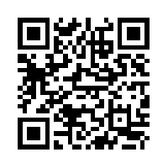
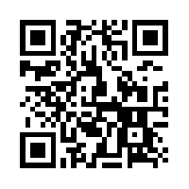
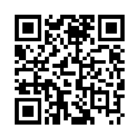
Station #10
1. In a tragedy, what is a break in the seriousness for a moment of comedy or silliness?
2. What is a word or phrase with more than one meaning, usually when the second meaning is risqué?
3. What do we call it when the audience or reader knows something that the characters in the story do not know?

Slide 12
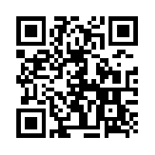
Station #11
1. What is a substitution of a more pleasant expression for one whose meaning may come across as rude or offensive (i.e. ―He passed away,‖ rather than ―He died.‖)?
2. What is writing or speech that is not meant to be taken literally? (often used to compare dissimilar objects; figurative language includes metaphor, simile, personification, and hyperbole)
3. What are hints of events to occur later in a story?

Slide 13
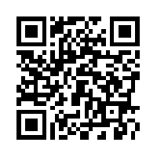
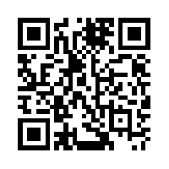
Station #12
1. What is a unit in poetry consisting of an unstressed syllable followed by a stressed syllable?
2. What is a 10-syllable line divided into 5 iambic feet (one unstressed syllable followed by one stressed syllable)? This is the basic rhythm of Shakespeare‘s verse.
3. What is language which works to evoke images in your mind (i.e. ―And with thy bloody and invisible hand / Cancel and tear to pieces that great bond / Which keeps me pale.‖)?
4. What is a contradiction between what is expected and what actually is—or appearance versus reality?

Slide 14
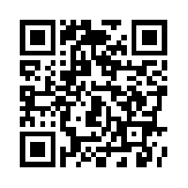
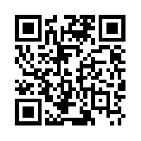
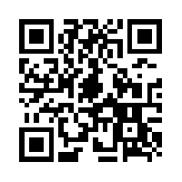
Station #13
1. What do we call it when two opposite terms are used together (i.e. ―O heavy lightness!‖)?
2. What is attributing human characteristics to non-human objects?
3. What is a normal speech rhythm? Shakespeare often wrote certain characters speaking either in all verse or all prose, indicating some personality trait of the character. If the character deviates from its normal form, be aware of a changing state of mind…often prose signals a character slipping into insanity!

Slide 15
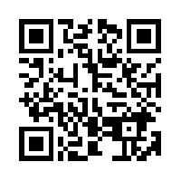
Station #14
1. What is a play on words, especially those that sound alike, but have different meanings (i.e. ―Ask for me tomorrow and you will find me a grave man‖)?
2. What are two rhyming lines at the end of a speech, signaling that a character is leaving the stage or that the scene is ending?
3. What is a figure of speech comparing two unlike things that is often introduced by like or as (i.e. ―My love is like a red, red rose‖)?

Slide 16
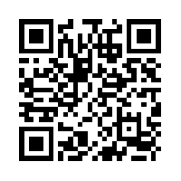
Station #15
1. Who is the Roman god of love?
2. Who is the Roman goddess of love?
3. Who is the Roman goddess of the hunt?

Slide 17
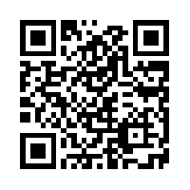
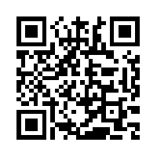
Station #16
1. Who is the king of the gods in Roman mythology?
2. Who is the Roman nymph who loved the sound of her own voice?
3. What is a Christian holiday celebrating the resurrection of Christ?
4. What is name of the plague beginning in the 14th century that killed nearly half of Europe’s population and continued until the 18th century?

Slide 18
GOALS ~I can adapt writing to audience and purpose.
5 minutes
Exit Ticket:
Of all that you learned today, what idea stands out the most to you? Why? Explain.

